Slide 1
Linux - Using Shell Variables

Slide 2
A variable is a character string to which we assign a value. The value assigned could be a number, text, filename, device, or any other type of data.
A variable is nothing more than a pointer to the actual data. The shell enables you to create, assign, and delete variables.

Slide 3

Variable Names
The name of a variable can contain only letters (a to z or A to Z), numbers ( 0 to 9) or the underscore character ( _).
By convention, Unix shell variables will have their names in UPPERCASE.
The following examples are valid variable names −

Slide 4
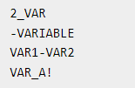
Following are the examples of invalid variable names −

Slide 5
Defining Variables
Variables are defined as follows −
variable_name=variable_value
For example −
NAME="Zara Ali“
The above example defines the variable NAME and assigns the value "Zara Ali" to it. Variables of this type are called scalar variables. A scalar variable can hold only one value at a time.
Shell enables you to store any value you want in a variable.
For example −
VAR1="Zara Ali"
VAR2=100

Slide 6
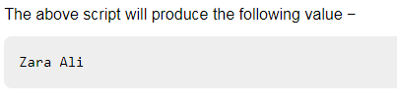
Accessing Values
To access the value stored in a variable, prefix its name with the dollar sign ($) −
For example, the following script will access the value of defined variable NAME and print it on STDOUT −
#!/bin/sh
NAME="Zara Ali"
echo $NAME

Slide 7
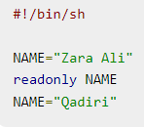
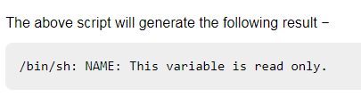
Read-only Variables
Shell provides a way to mark variables as read-only by using the read-only command. After a variable is marked read-only, its value cannot be changed.
For example, the following script generates an error while trying to change the value of NAME −

Slide 8
Unsetting Variables
Unsetting or deleting a variable directs the shell to remove the variable from the list of variables that it tracks. Once you unset a variable, you cannot access the stored value in the variable.
Following is the syntax to unset a defined variable using the unset command −
unset variable_name The above command unsets the value of a defined variable. Here is a simple example that demonstrates how the command works −
#!/bin/sh
NAME="Zara Ali"
unset NAME
echo $NAME
The above example does not print anything. You cannot use the unset command to unset variables that are marked readonly.

Slide 9
Variable Types
When a shell is running, three main types of variables are present −
Local Variables − A local variable is a variable that is present within the current instance of the shell. It is not available to programs that are started by the shell. They are set at the command prompt.
Environment Variables − An environment variable is available to any child process of the shell. Some programs need environment variables in order to function correctly. Usually, a shell script defines only those environment variables that are needed by the programs that it runs.
Shell Variables − A shell variable is a special variable that is set by the shell and is required by the shell in order to function correctly. Some of these variables are environment variables whereas others are local variables.

Slide 10
var.sh
#!/bin/sh MY_MESSAGE="Hello World" echo $MY_MESSAGE

Slide 11
MY_MESSAGE="Hello World" MY_SHORT_MESSAGE=hi MY_NUMBER=1 MY_PI=3.142 MY_OTHER_PI="3.142" MY_MIXED=123abc

Slide 12
echo What is your name? read MY_NAME echo "Hello $MY_NAME - hope you're well."

Slide 13
Special Variables
These variables are reserved for specific functions.
For example, the $ character represents the process ID number, or PID, of the current shell −
$echo $$
The above command writes the PID of the current shell −
29949

Slide 14
Sr. No. | Parameters & Description
1 | $0 The filename of the current script.
2 | $n These variables correspond to the arguments with which a script was invoked. Here n is a positive decimal number corresponding to the position of an argument (the first argument is $1, the second argument is $2, and so on).
3 | $# The number of arguments supplied to a script.
4 | $* All the arguments are double quoted. If a script receives two arguments, $* is equivalent to $1 $2.
5 | $@ All the arguments are individually double quoted. If a script receives two arguments, $@ is equivalent to $1 $2.

Slide 15
6 | $? The exit status of the last command executed.
7 | $$ The process number of the current shell. For shell scripts, this is the process ID under which they are executing.
8 | $! The process number of the last background command.

Slide 16
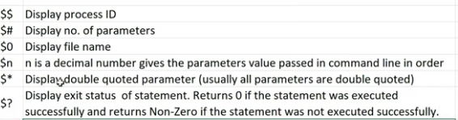

Slide 17


Slide 18
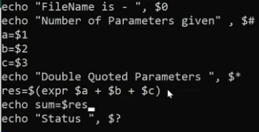

Slide 19
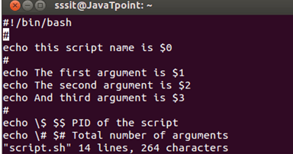

Slide 20
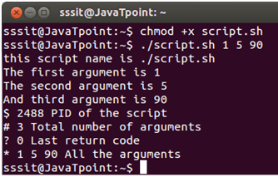

Slide 21
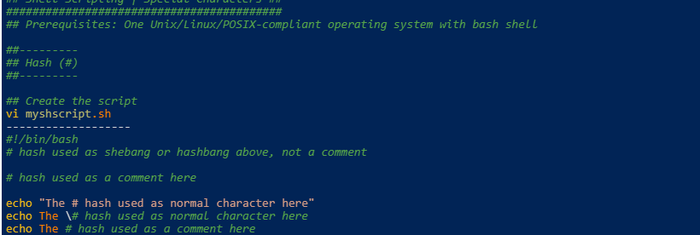
Shell Scripting – Special Characters:
Hash (#):
The general use case of hash (#) is to define a comment in the shell but hash (#) can also be used for shebang, parameter substitution, and base conversion.

Slide 22
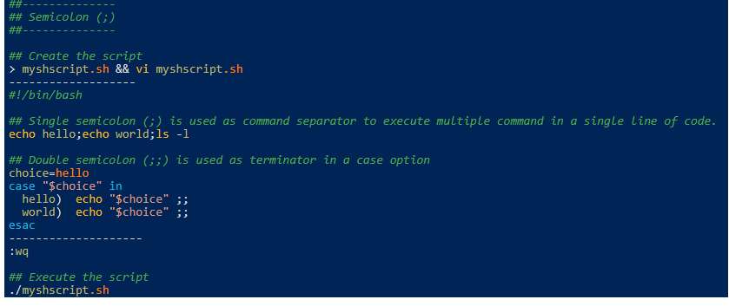
Semicolon (;):
The single semicolon (;) is used to execute multiple commands in a single line, the double semicolon (;;) is used as terminator in a case option.

Slide 23
Dot (.):
The single dot (.) represent different use case depending upon the usage in your script. It can be used to represent a hidden file, the current working directory, a single character replacement in regular expression. The double dot (..) is used to represent the parent directory of current working directory.

Slide 24
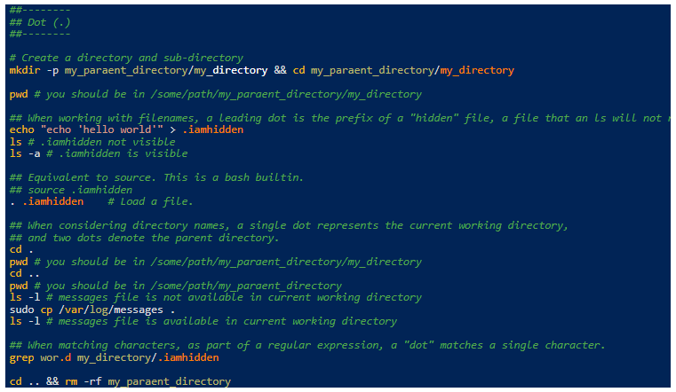

Slide 25
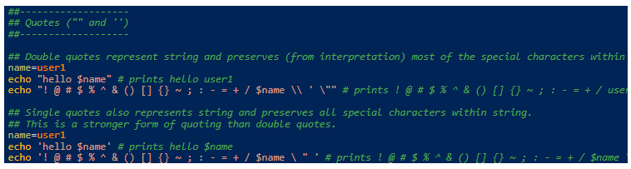
Quotes (“” and ”):
Double quotes (“”) represent string and preserves (from interpretation) most of the special characters within a string. The single quotes (”) represents string and preserves all special characters within a string. This is a stronger form of quoting than double-quotes.

Slide 26
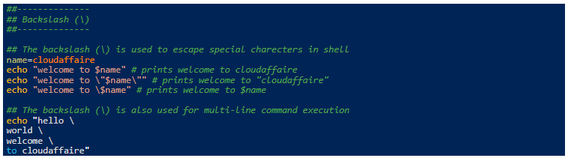
Backslash (\):
Backslash (\) is used to escape other special characters in the shell.

Slide 27
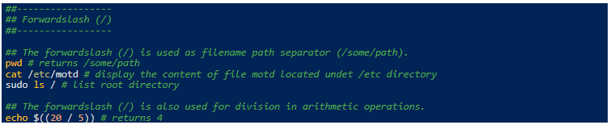
Forward slash (/):
The forward-slash (/) is used as a filename path separator (/some/path). It also represents the root directory. In arithmetic operation forward slash means division.

Slide 28
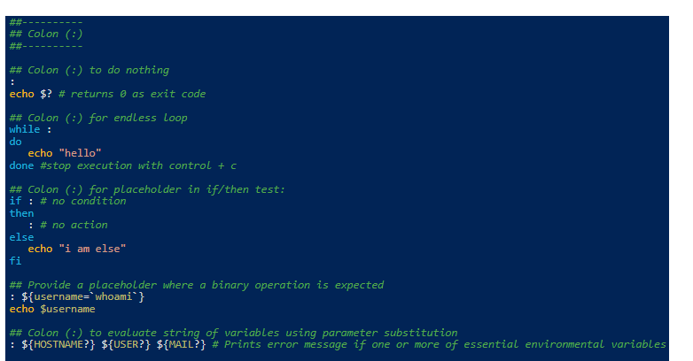
Colon (:):
In shell, a colon (:) can be used as a null command, endless loop, a place holder, for string evaluation, for field separator or to empty a file.

Slide 29
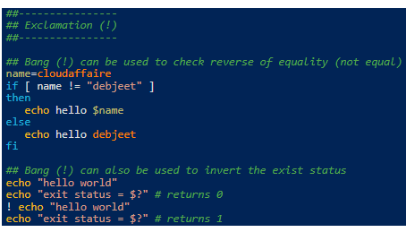
Exclamation (!):
Bang (!) can be used to check the reverse of equality (not equal). Bang (!) can also be used to invert the exit status.

Slide 30
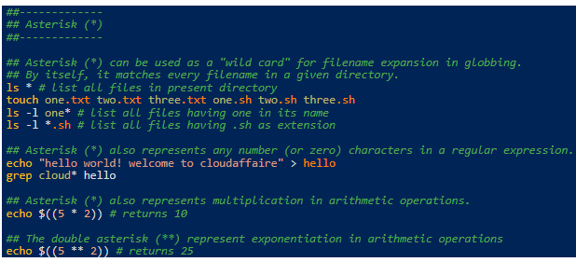
Asterisk (*):
Asterisk (*) can be used as a “wild card” for filename expansion in globbing. By itself, it matches every filename in a given directory. Asterisk (*) also represents any number (or zero) characters in a regular expression. In arithmetic operation single asterisk (*) represents multiplication and double asterisk (**) represents exponentiation.

Slide 31
Processes in Linux
A program/command when executed, a special instance is provided by the system to the process. This instance consists of all the services/resources that may be utilized by the process under execution.
Whenever a command is issued in Unix/Linux, it creates/starts a new process. For example, pwd when issued which is used to list the current directory location the user is in, a process starts.
Through a 5 digit ID number Unix/Linux keeps an account of the processes, this number is call process ID or PID. Each process in the system has a unique PID.
Used up pid’s can be used in again for a newer process since all the possible combinations are used.
At any point of time, no two processes with the same pid exist in the system because it is the pid that Unix uses to track each process.

Slide 32
Initializing a process
Method 1: Foreground Process : Every process when started runs in foreground by default, receives input from the keyboard, and sends output to the screen. When issuing pwd command
$ pwd
Output:
$ /home/geeksforgeeks/root
When a command/process is running in the foreground and is taking a lot of time, no other processes can be run or started because the prompt would not be available until the program finishes processing and comes out.

Slide 33
Method 2: Background Process: It runs in the background without keyboard input and waits till keyboard input is required. Thus, other processes can be done in parallel with the process running in the background since they do not have to wait for the previous process to be completed. Adding & along with the command starts it as a background process
$ pwd &
Since pwd does not want any input from the keyboard, it goes to the stop state until moved to the foreground and given any data input. Thus, on pressing Enter: Output:
[1] + Done pwd
$
That first line contains information about the background process – the job number and the process ID. It tells you that the ls command background process finishes successfully. The second is a prompt for another command.

Slide 34

Tracking ongoing processes
ps (Process status) can be used to see/list all the running processes.
$ ps
PID TTY TIME CMD
19 pts/1 00:00:00 sh
24 pts/1 00:00:00 ps
For more information -f (full) can be used along with ps
$ ps –f

Slide 35
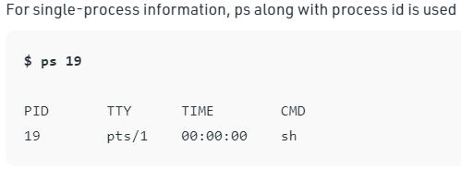

Slide 36
For a running program (named process) Pidof finds the process id’s (pids) Fields described by ps are described as:
UID: User ID that this process belongs to (the person running it)
PID: Process ID
PPID: Parent process ID (the ID of the process that started it)
C: CPU utilization of process
STIME: Process start time
TTY: Terminal type associated with the process
TIME: CPU time is taken by the process
CMD: The command that started this process

Slide 37
There are other options which can be used along with ps command :
-a: Shows information about all users
-x: Shows information about processes without terminals
-u: Shows additional information like -f option
-e: Displays extended information
Stopping a process: When running in foreground, hitting Ctrl + c (interrupt character) will exit the command. For processes running in background kill command can be used if it’s pid is known.

Slide 38
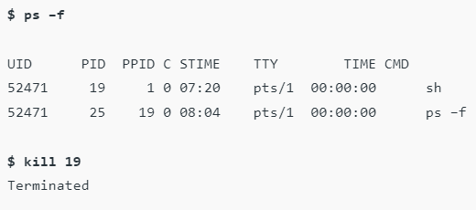
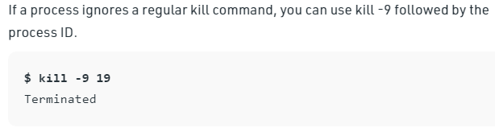

Slide 39
nice: It starts a new process (job) and assigns it a priority (nice) value at the same time. Syntax:
nice [-nice value] nice value ranges from -20 to 19, where -20 is of the highest priority.
renice : To change the priority of an already running process renice is used. Syntax:
renice [-nice value] [process id]

Slide 40
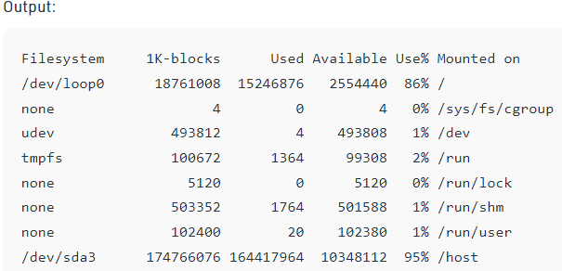
df: It shows the amount of available disk space being used by file systems Syntax:
df

Slide 41
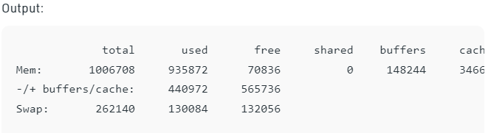
free: It shows the total amount of free and used physical and swap memory in the system, as well as the buffers used by the kernel Syntax:
free

Slide 42
Types of Processes
Parent and Child process : The 2nd and 3rd column of the ps –f command shows process id and parent’s process id number. For each user process, there’s a parent process in the system, with most of the commands having shell as their parent.
Zombie and Orphan process : After completing its execution a child process is terminated or killed and SIGCHLD updates the parent process about the termination and thus can continue the task assigned to it. But at times when the parent process is killed before the termination of the child process, the child processes become orphan processes, with the parent of all processes “init” process, becomes their new pid. A process which is killed but still shows its entry in the process status or the process table is called a zombie process, they are dead and are not used.

Slide 43
Daemon process :Daemons are processes that are often started when the system is bootstrapped and terminate only when the system is shut down. Because they don’t have a controlling terminal, they run in the background. UNIX systems have numerous daemons that perform day-to-day activities.

